Slide 1

Build Tool
A build tool is a script, framework, or any kind of software created specifically for a given programming language to compile code, run tests on it, or do other operations needed for a build.

Slide 2
WHY BUILD TOOL?
Software build tools are used to automate the creation of executable applications from source code.

Slide 3
FRAMEWORK
A framework is a structure that you can build software on. It serves as a foundation, so you’re not starting entirely from scratch. Frameworks are typically associated with a specific programming language and are suited to different types of tasks.

Slide 4
APPLICATION LANGUAGE | FRAME WORK | BUILD TOOL
JAVA | SPRING BOOT | MAVEN & GRADLE
.NET | .NET Framework | MS BUILD
Node JS | EXPRESS .JS | NPM

Slide 5
What is Maven?
A Java project management and integration build tool.
Based on the concept of XML Project Object Model (POM).
Originally developed for building Turbine.
A small core with numerous plugins (in Jelly).
Notes:
Two scenarios drove Maven to us:
As a Java developer who is involved with building the application. Like to be able to reuse the build scripts, as simple as making a Java API call.
As a project manager/team lead who is trying to keep up-to-date with inter-dependencies among components.

Slide 6
Project Object Model (POM)
Projects are described as Project Object Model.
Project Management
  Detailed description of the project.
  Company information.
  Developer roles and information.
  Mailing list and source control modules configuration.
Project Build
  Source code and test code location.
  Resources location
Notes:
The POM consists of four sections.

Slide 7
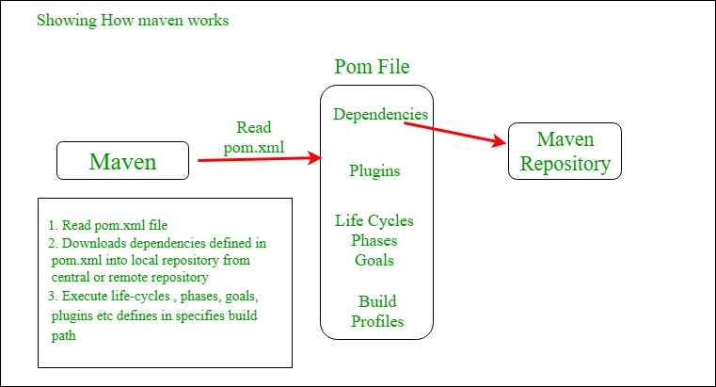

Slide 8
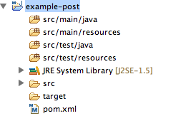
JAVA Project Structure

Slide 9
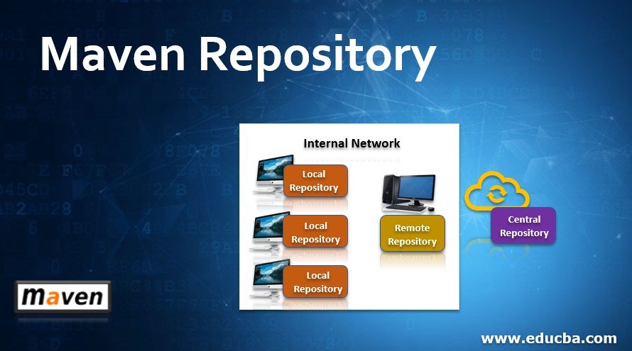

Slide 10
Maven Repos
Local Repository : Maven local repository is a folder location on your machine. It gets created when you run any maven command for the first time.
Central Repository: When Maven does not find any dependency in local repository, it starts searching in central repository using following URL
Remote Repository: Maven does not find a mentioned dependency in central repository as well. It then stops the build process and output error message to console. To prevent such situation, Maven provides concept of Remote Repository, which is developer's own custom repository containing required libraries or other project jars.

Slide 11
MS Build
The Microsoft Build Engine is a platform for building applications. This engine, which is also known as MS Build, provides an XML schema for a project file that controls how the build platform processes and builds software. Visual Studio uses MS Build, but MS Build doesn't depend on Visual Studio.

Slide 12
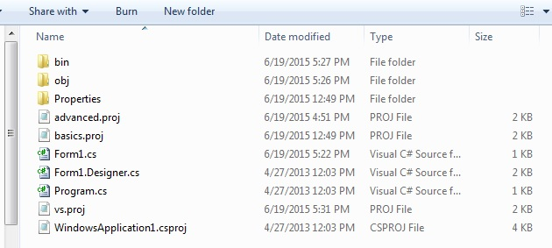
PROJECT FILE

Slide 13
NPM BUILD TOOL
This package makes it easy to develop web applications that use the latest ES6 syntax. It can also work for smaller projects like libraries and NPM packages.
It does this by exposing a small set of easy-to-use CLI commands to quickly compile files, test, deploy, and even create releases for your entire project.

